Slide 1



Slide 2


HI , I’m Colin McNamara
Entrepreneur: Co-founder of Always Cool Brands, focusing on private-label products and health-conscious goods (LangChain User)
Co-Founder of Austin LangChain AIMUG: An 1100+ member AI community in Austin.
10% Developer: Former Oracle Cloud Infrastructure lead with experience in hyper-scale cloud building, operations, engineering, and design.
Public Good: Helping our community succeed
LinkedIn:

Slide 3
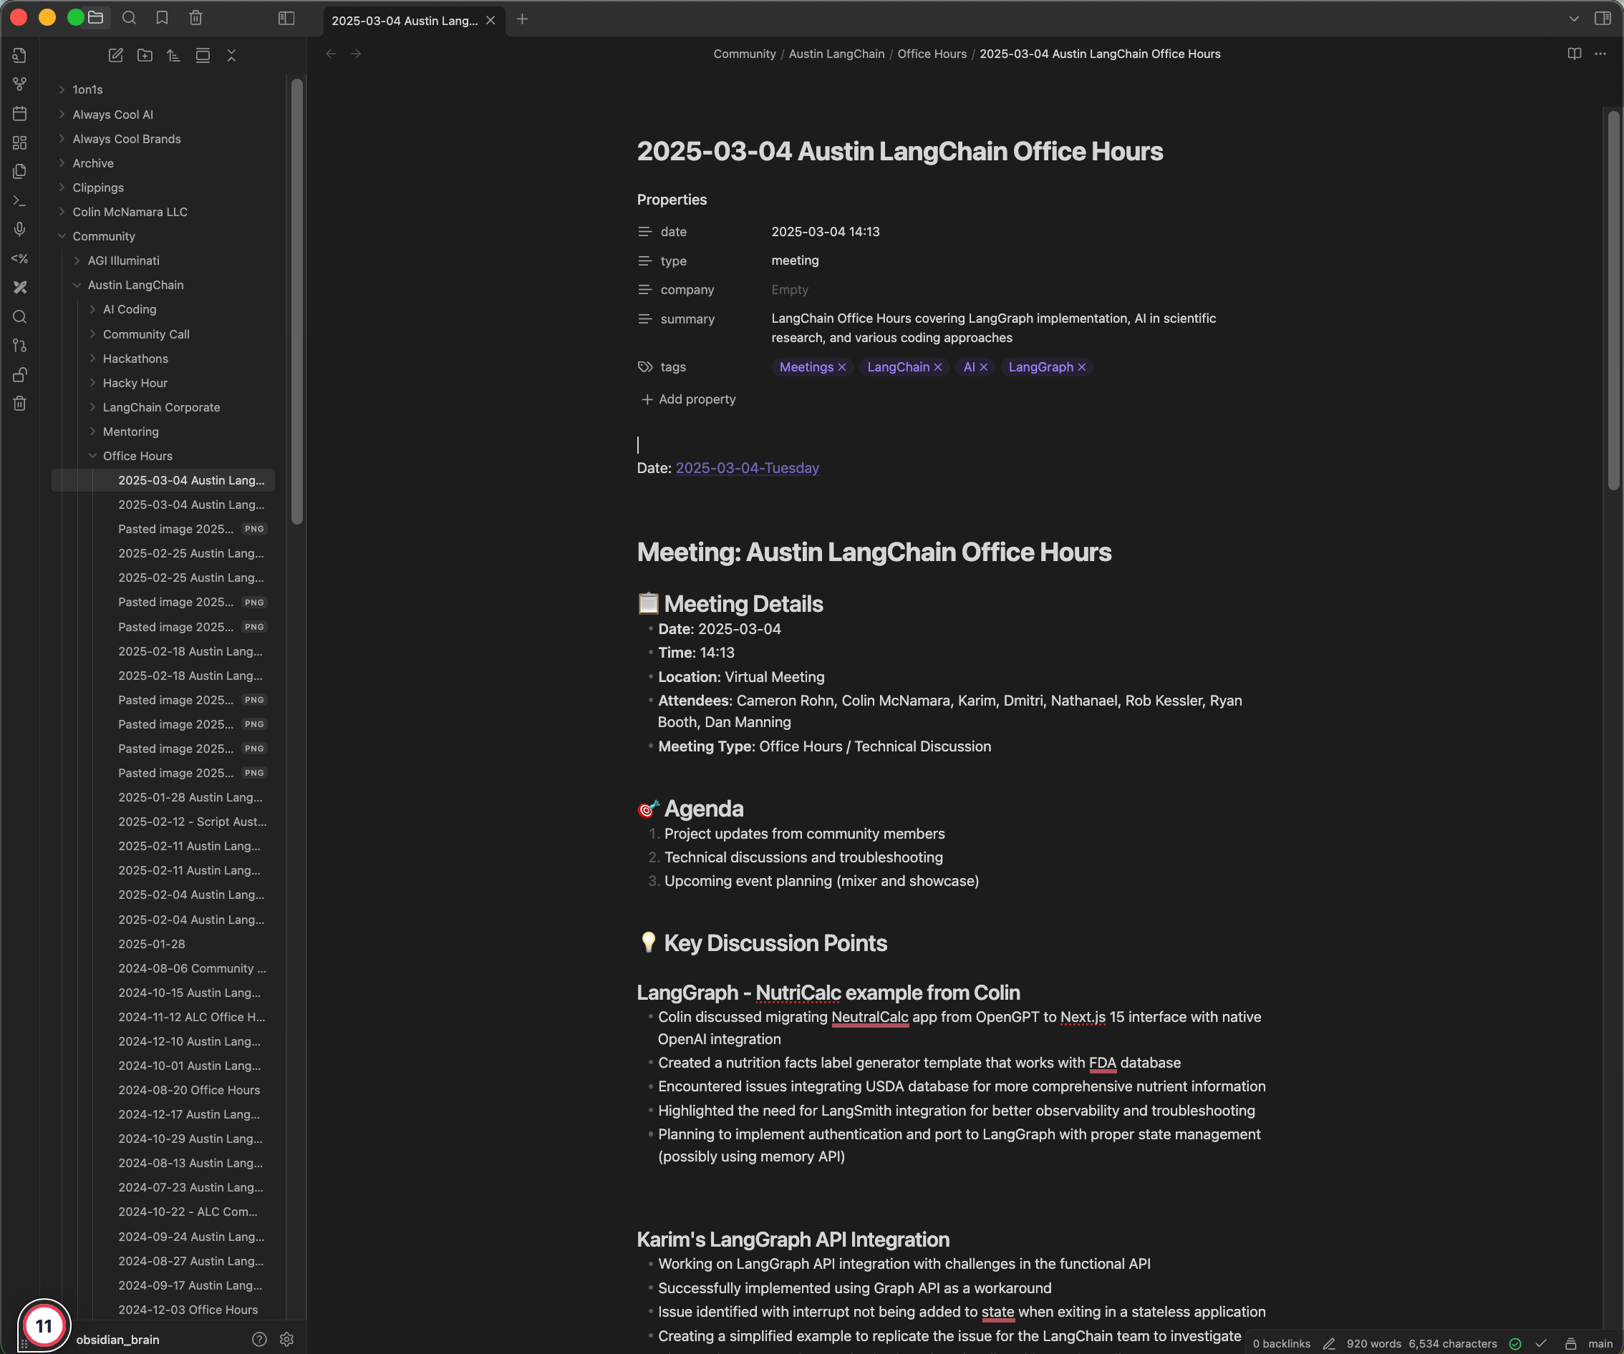
I love obsidian

Slide 4
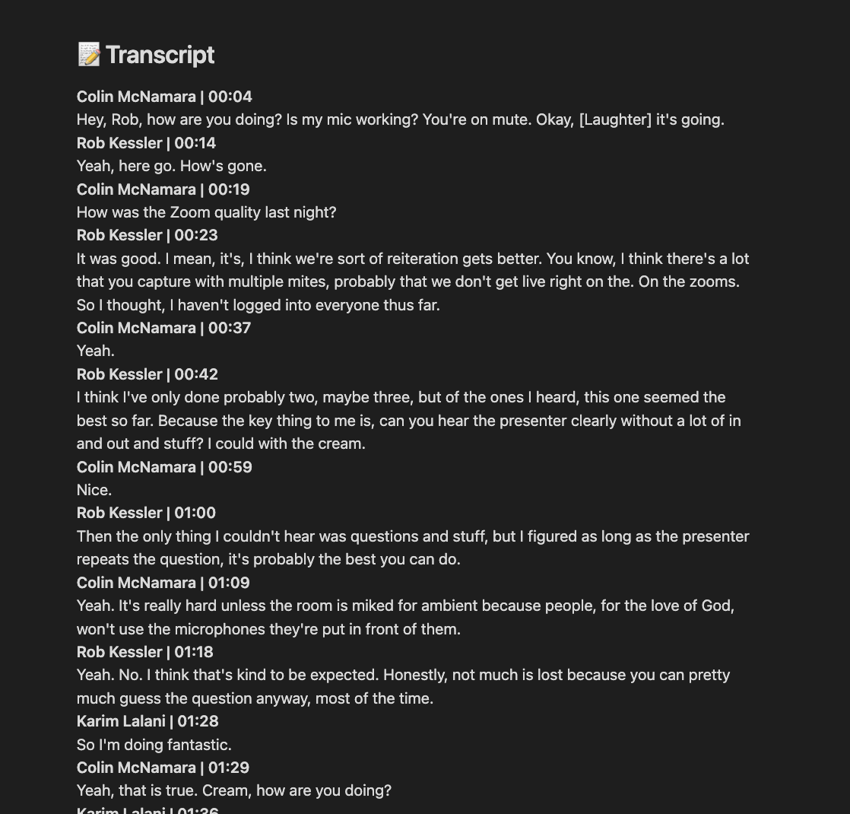
Why I love obsidian – Transcripts

Slide 5
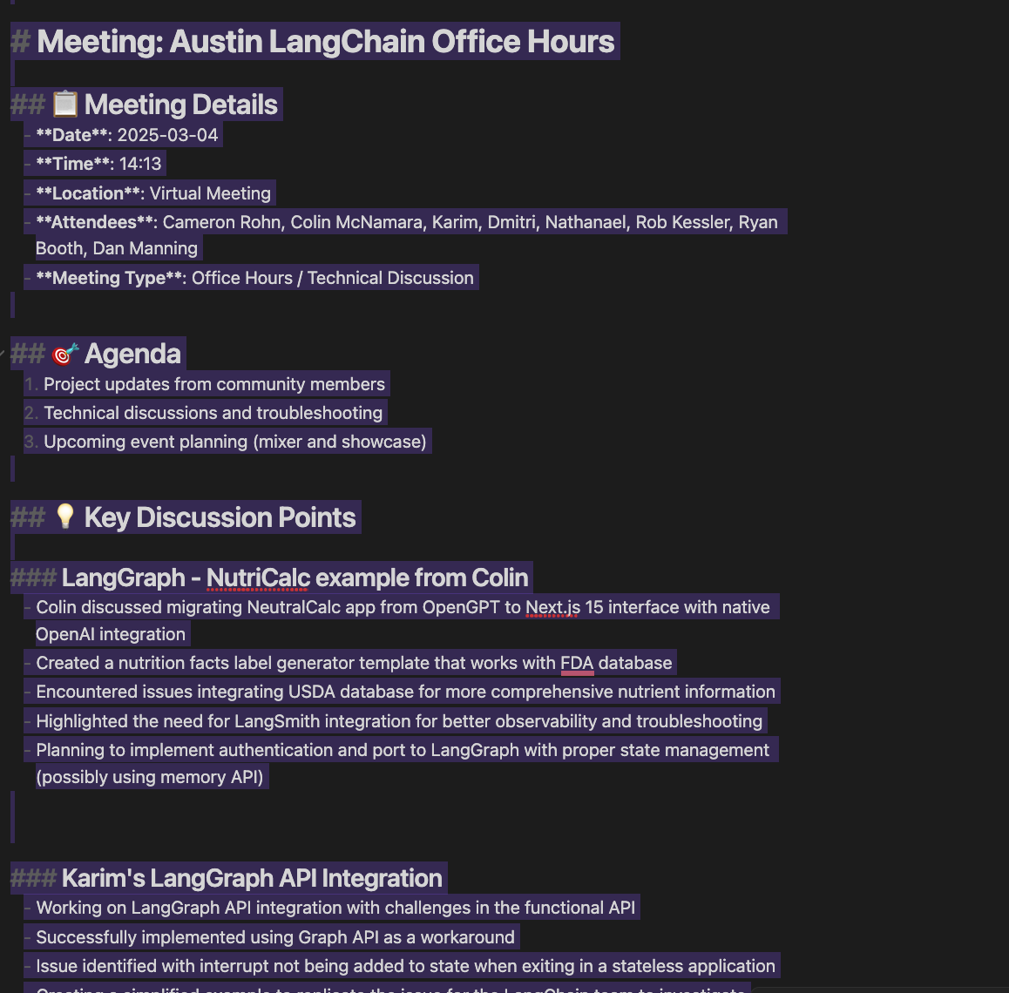
Why I love obsidian – Markdown

Slide 6
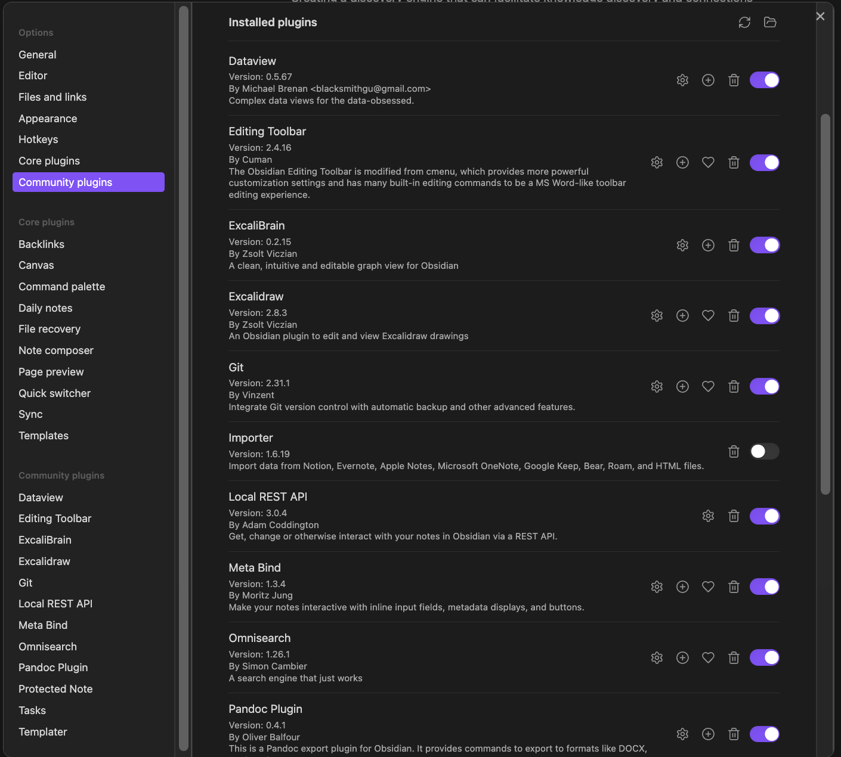
Why I love obsidian – Plugins

Slide 7
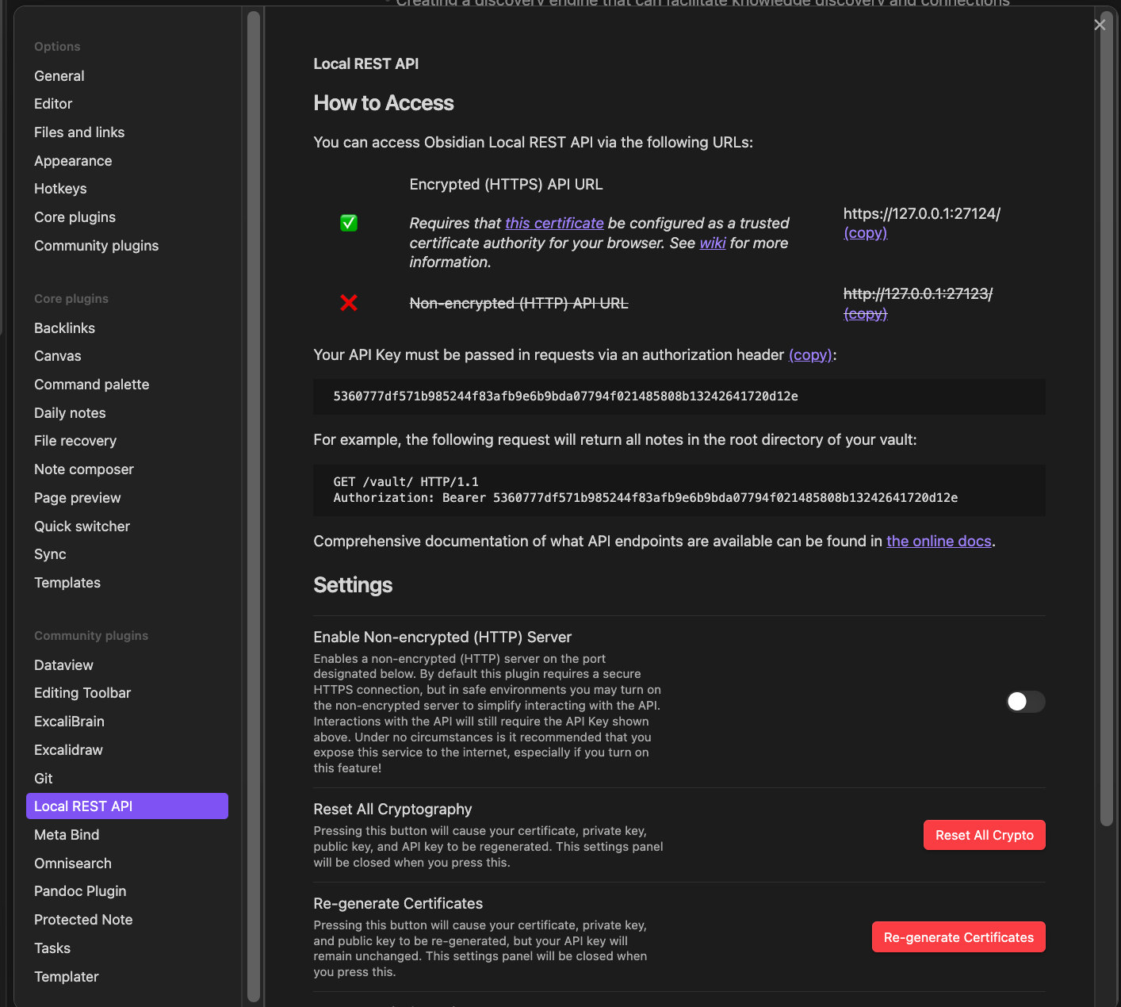
Why I love obsidian – API (accessible via MCP)

Slide 8
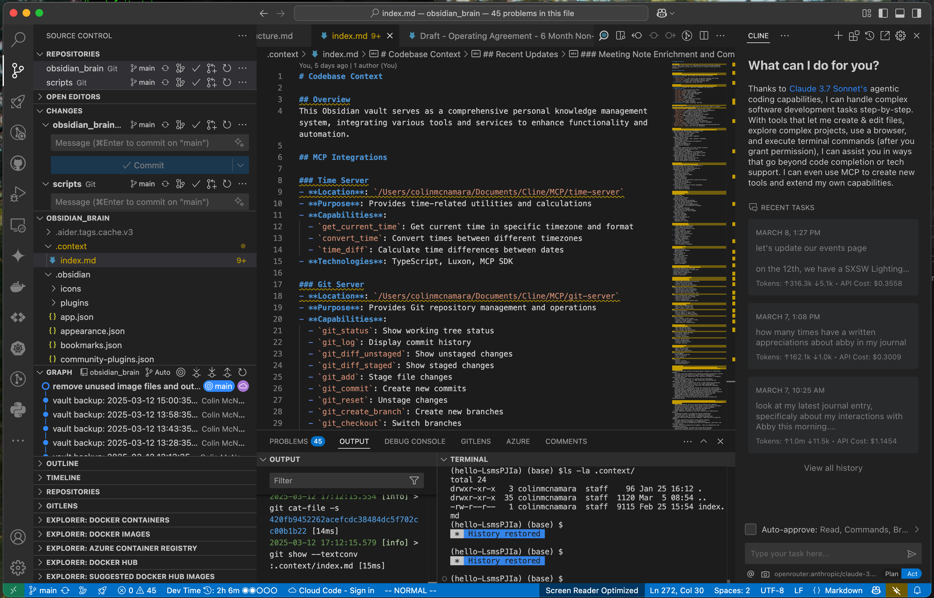
Why I love obsidian – VSCODE
Markdown Based:
Plugin : Learning AI through the Lense of Lanhain, pulling the ecosystem together. gC
Engaged, Active Attendees: A mix of local innovators, enthusiasts, and early adopters.
Supportive & Engaged Community: A well-balanced Discord that’s "useful, but not overwhelming."

Slide 9
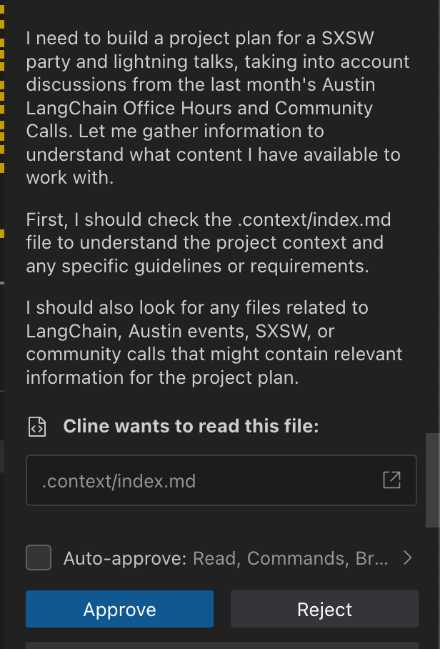
Why I love obsidian – CLINE + MCP

Slide 10
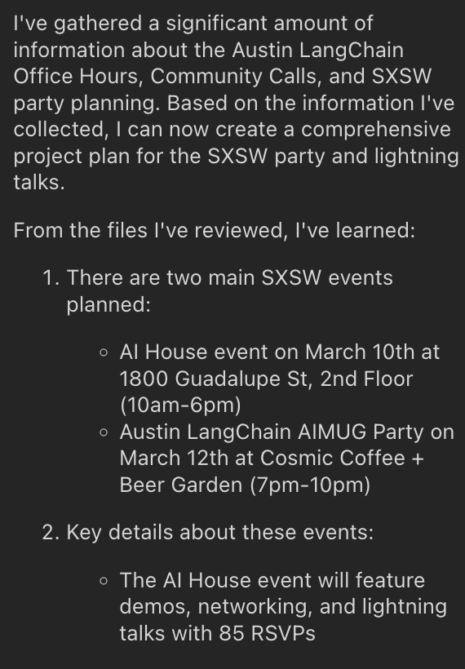
Why I love obsidian – Project Management

Slide 11
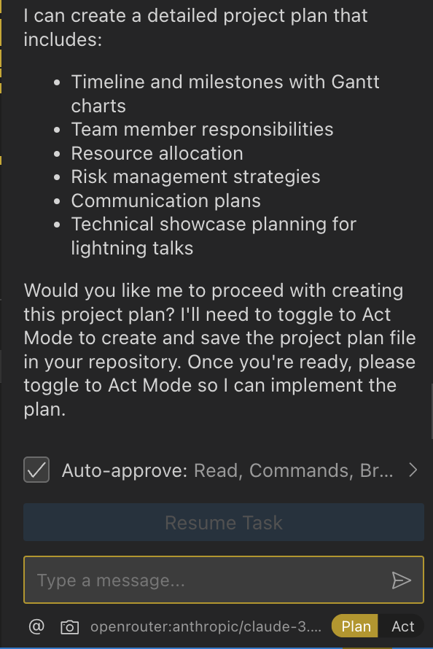
Why I love obsidian – Project Management

Slide 12
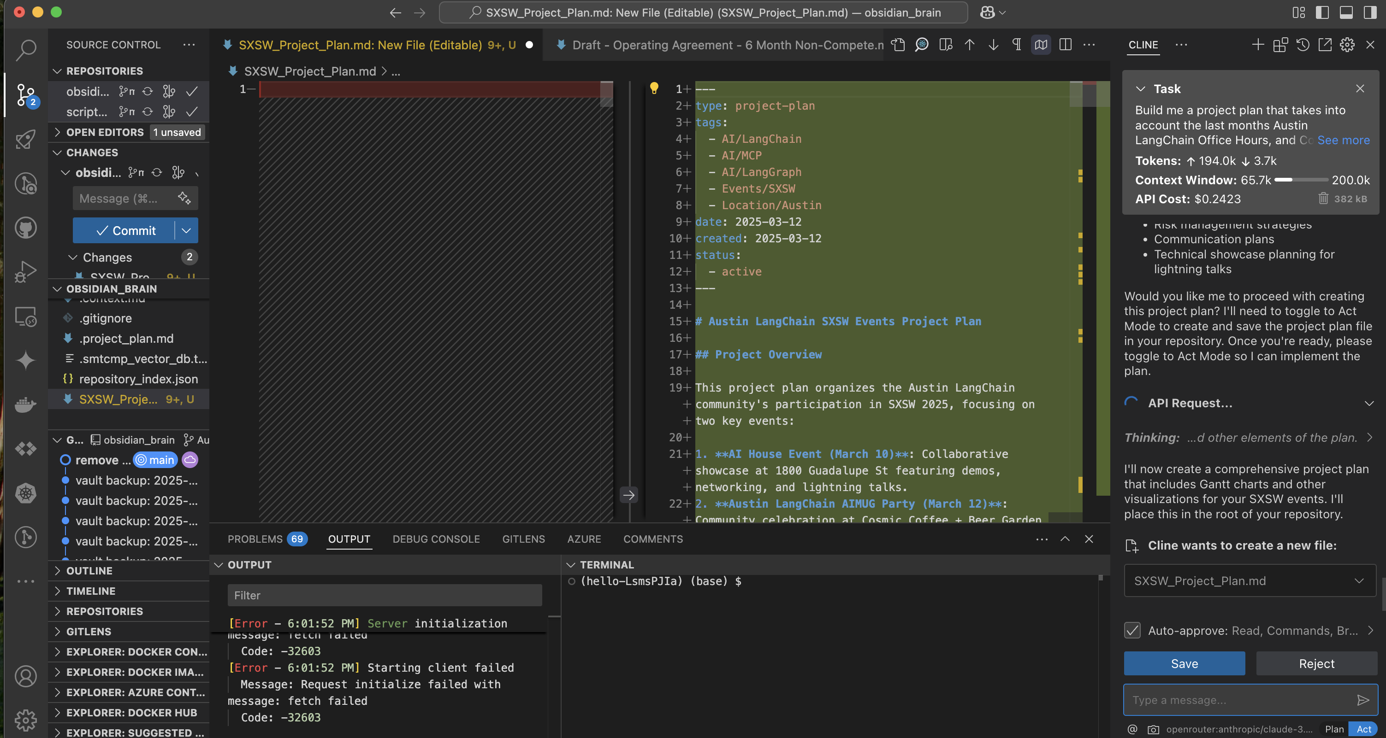
Why I love obsidian – Project Management

Slide 13
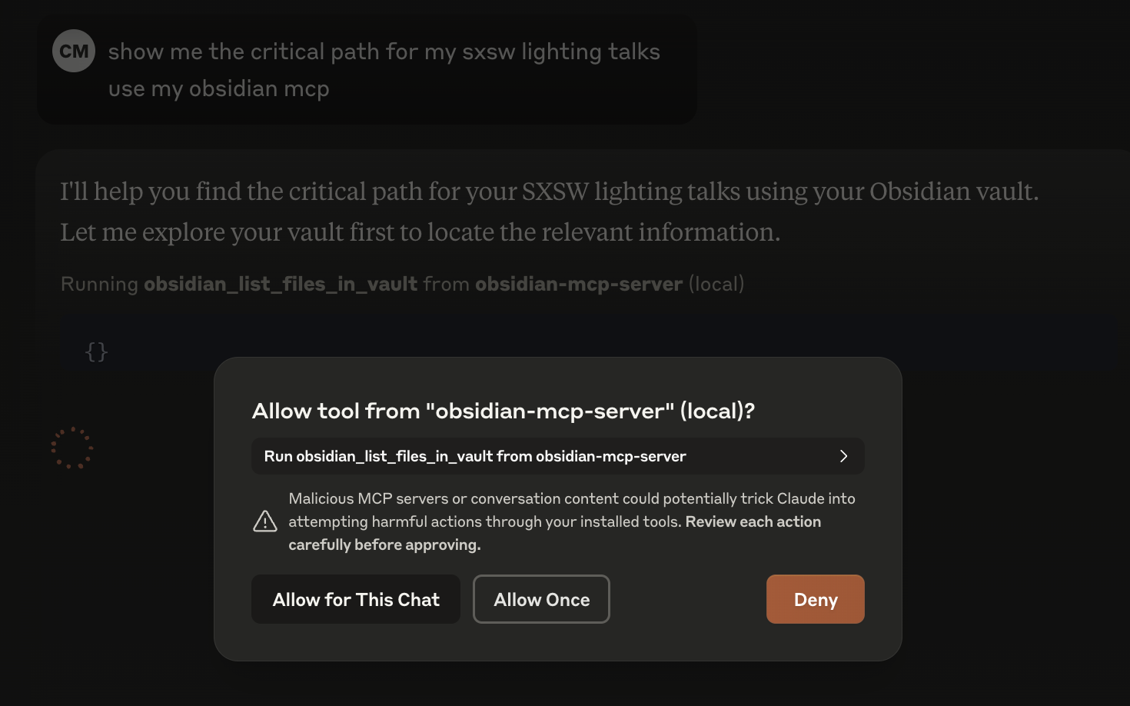
But wait … you can do this in Claude Desktop
Markdown Based:
Plugin : Learning AI through the Lense of Lanhain, pulling the ecosystem together. gC
Engaged, Active Attendees: A mix of local innovators, enthusiasts, and early adopters.
Supportive & Engaged Community: A well-balanced Discord that’s "useful, but not overwhelming."

Slide 14
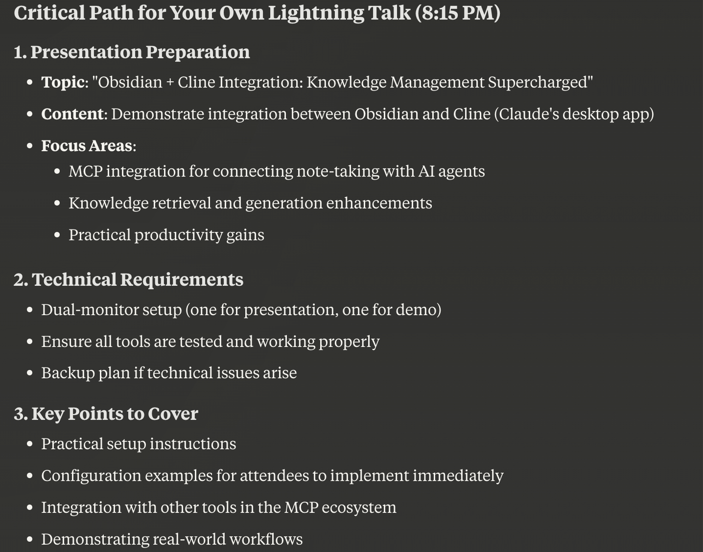
But wait … you can do this in Claude Desktop
Markdown Based:
Plugin : Learning AI through the Lense of Lanhain, pulling the ecosystem together. gC
Engaged, Active Attendees: A mix of local innovators, enthusiasts, and early adopters.
Supportive & Engaged Community: A well-balanced Discord that’s "useful, but not overwhelming."

Slide 15
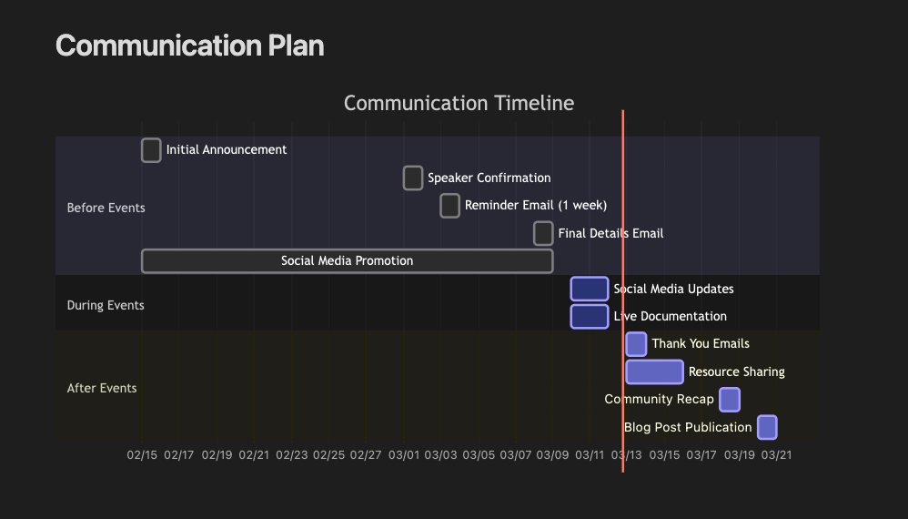
Why I love obsidian – Project Management

Slide 16
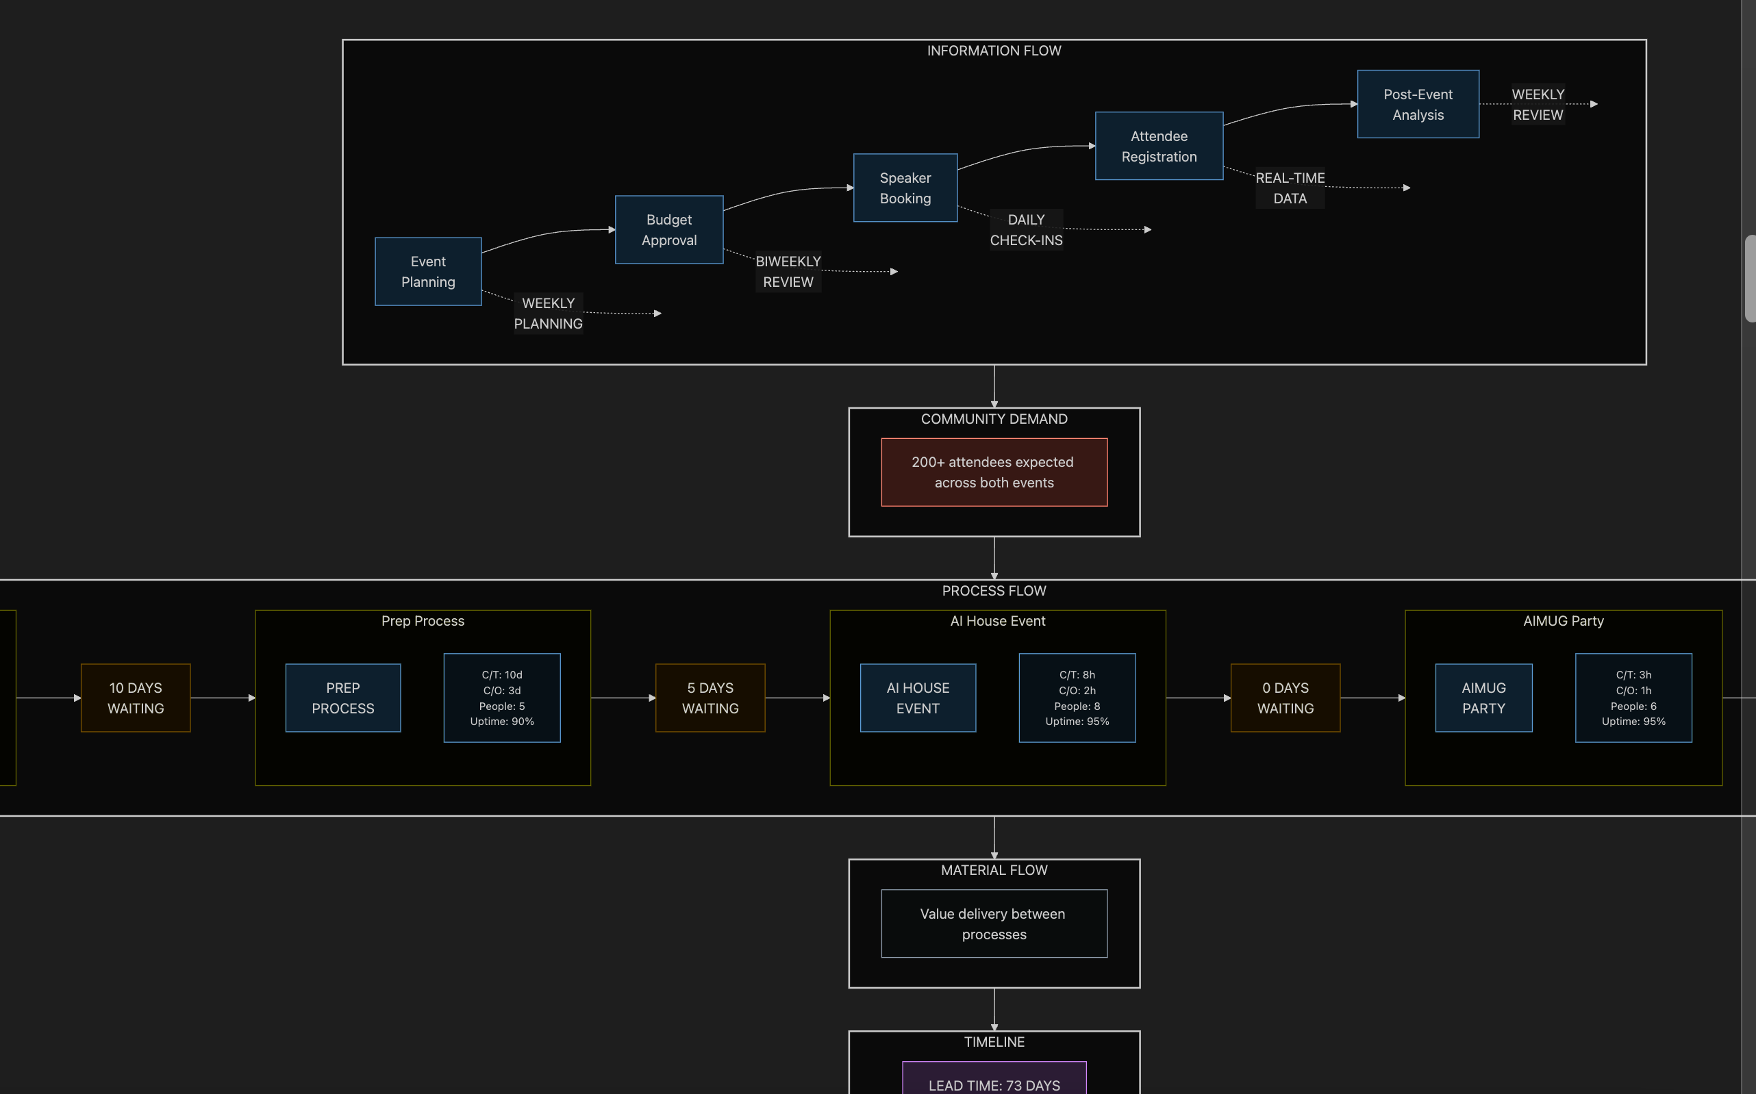
My Continued Love Affair with Mermaid

Slide 17
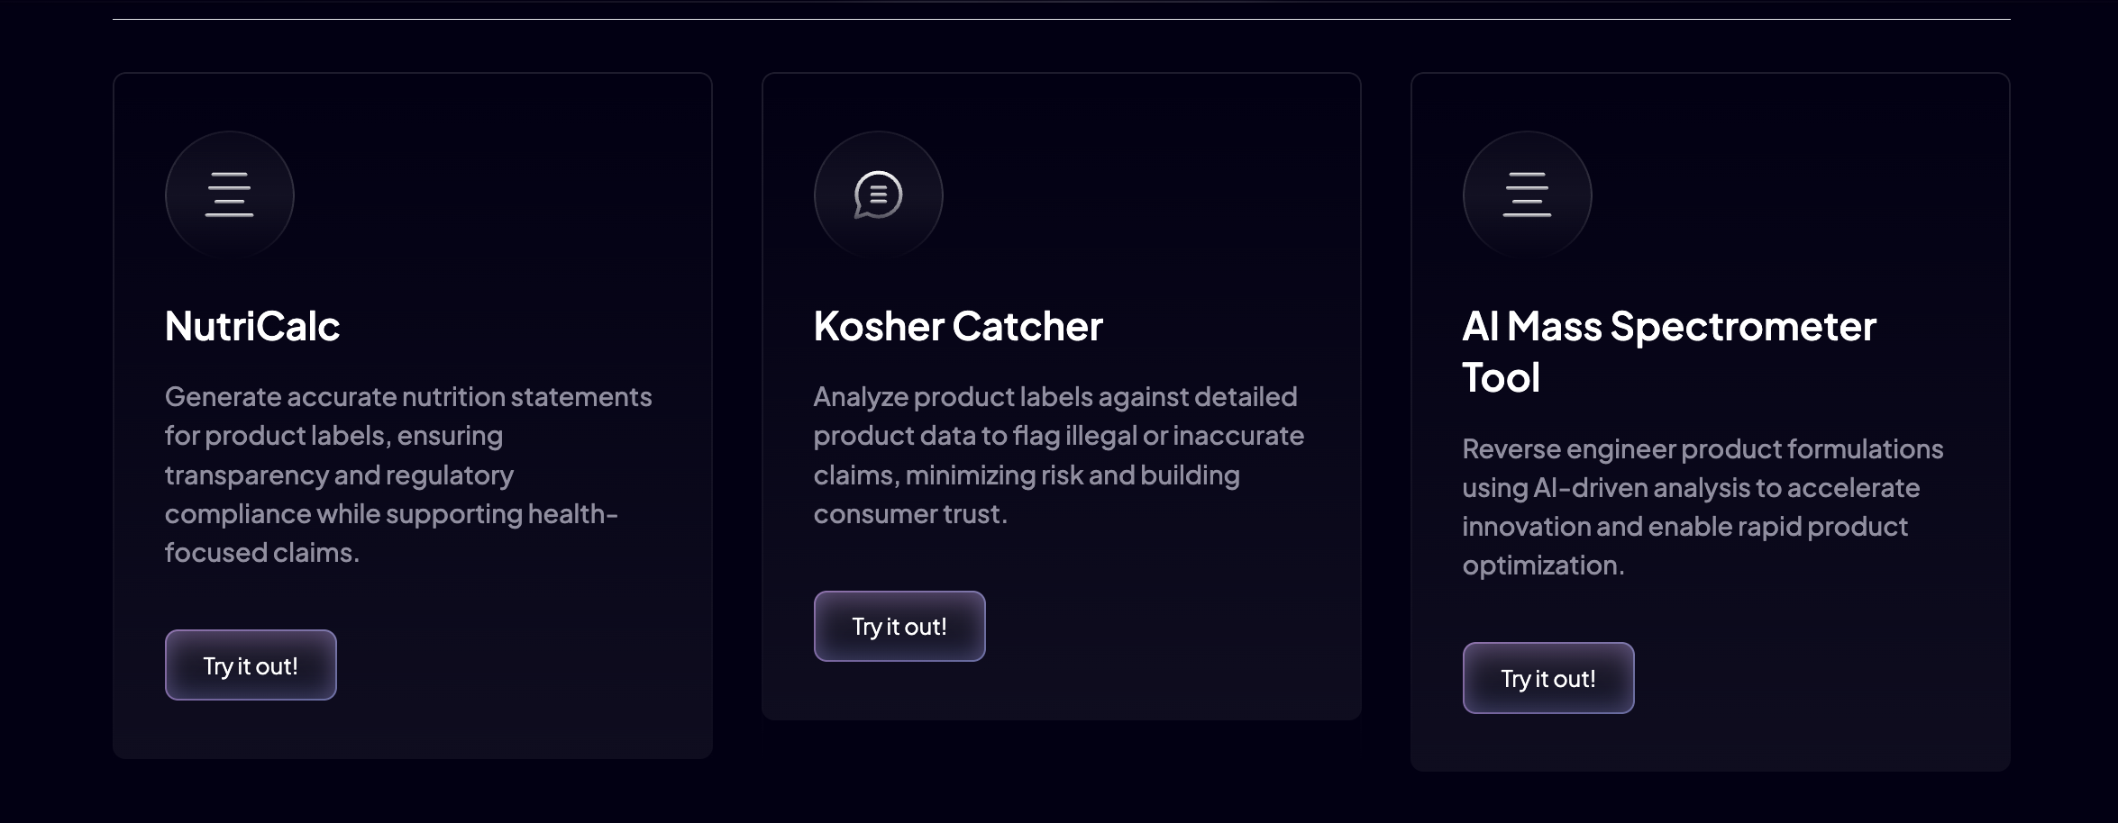
Where does LangChain / LangGraph come in?
In progress of porting to Next.js + LangGraph pipelines
Currently porting my VSCODE + CLINE processes
Joining its friends on our internal platform at Always Cool

Slide 18


